Slide 1

Welcome and Thank You!
Please Remeber to Mute your Mics Call in: +1-415-655-0002
Meeting number (access code): 132 097 3363
Password: s9UtyWAMD65
Notes:
Amanda Flanary
Housekeeping
Happy to have you with us today as we kick-off our refreshed webinar series for the fiscal year

Slide 2
Mission of the Kentucky Governor’s Office of Early Childhood
Provide leadership and direction for the Commonwealth by providing a comprehensive and sustainable prenatal to age five early childhood system that will ensure a strong foundation for all children.
Notes:
Amanda Flanary
Thank you for your commitment to children and families in the Commonwealth
I’m proud to have you meet my colleagues /the rest of the team at the Kentucky Governor’s Office of Early Childhood

Slide 3
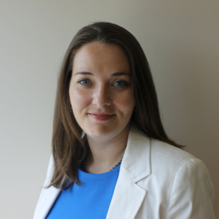
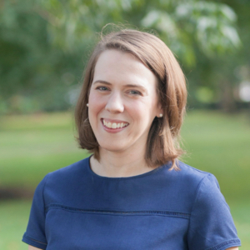
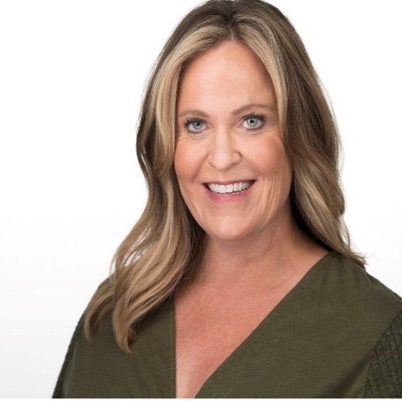
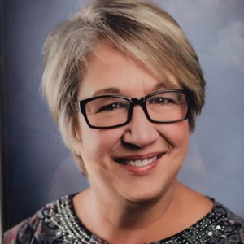
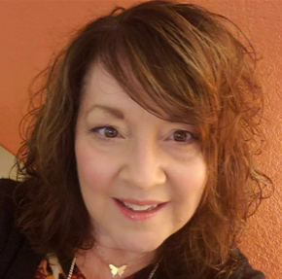
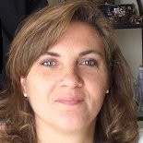

Meet the Team
  Amanda Flanary Amanda Riley Amy Neal Brenda Hagan
Project Manager Budget Analyst Executive Director Project Specialist
Juanita Webb Sally Shepherd Savannah Propst
  Project Manager Deputy Executive Director Administrative Assistant
    State Head Start Collaboration Director
Notes:
Amanda Flanary
Introduce Names (in Alphabetical Order) and Correct Titles . Pictures and Titles will be on Slide.
Transition to Amy Neal
As the Commonwealth’s leader in uniting the most effective organizations & influencers around the first, critical years of a child’s life, the Governor’s Office of Early Childhood –we are so excited to work with you in innovative ways to ensure that more children enter school strong
We’ve organized our team to manage the core functions of the office including: Vision, Promotion of Shared Measurement, Alignment of Strategies and Resources, Building Public Will and Advancing Public Policy and Securing New and Innovative Funding Sources at the State and Local Levels

Slide 4
Kentucky Early Childhood System Timeline
2010 – Gov. Office of Early Childhood created and
School Readiness Definition approved
2003 – Establishment of Early Childhood Standards
2014 – Kindergarten Readiness Screener and
Race to The Top received
2000- KIDS Now! Legislation
2019 – Preschool Development Grant
Notes:
Amy Neal
1. Kentucky has been a leader in the early care and education space
Kentucky’s long history as a pace setter for early childhood programming
2000 - Kids NOW! Legislation that dedicated 25% of Tobacco Master Settlement dollars directly to the support of children from birth to 5
FY18 $28 mil to support a wide range of programs including HANDS, Child Care and Development Fund, the Folic Acid Program among others.
2003 - Kentucky Early Childhood Standards As one of the first states in the nation to create a early childhood development framework for early care and education professionals
2010 – School Readiness Definition Defining what early care and educations means in the state led a shared understanding of what it means for children to reach kindergarten ready
2014 – Statewide Kindergarten Readiness screener to begin to measure where children are when they enter kindergarten.
$43 mil for the federal Race to The Top grant that allowed Kentucky to update Kentucky All STARS, enhanced data collection, and implemented family engagement practices
2019 – Kentucky received $10.6 mil to create a five year strategic plan and a comprehensive needs assessment to better understand the early care and education landscape

Slide 5
Community Early Childhood Councils
Mobilizing local community members to build innovative, collaborative partnerships that promote school readiness.
Notes:
Amy Neal
2000 - Kids NOW! Legislation included the establishment of Community Early Childhood Councils
With the goal of mobilizing local communities members to build innovative, collaborative partnerships that promote school readiness
All of this knowing that the work happens at the local level and that the research is very clear
That that when children start behind, it is likely they will stay behind

Slide 6
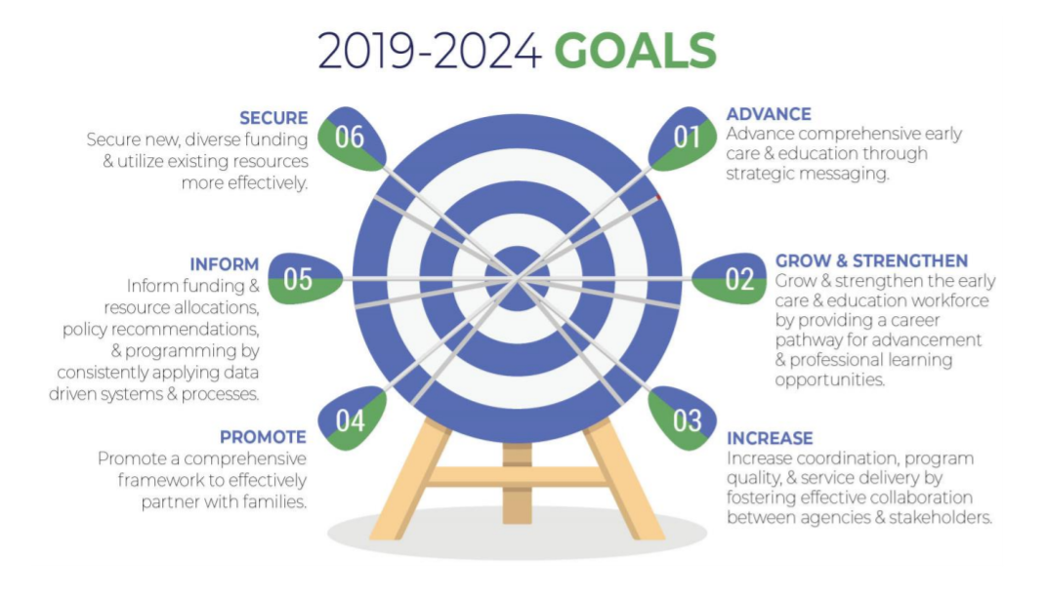
Notes:
Amy Neal
2019 Preschool Development(Planning) Grant from the United States Administration for Children and Families
The goals was to help states complete planning exercises to focus systems building----we got a great dive into the early childhood education landscape
Through that, we were able to develop a Five year Strategic Plan; approved by the Early Childhood Advisory Council
The Plan is available on our website https://kyecac.ky.gov/about/Pages/Advisory-Council-Meeting-Documents.aspx

Slide 7
Key Priorities to Accelerate Change
1.) Unification and Accountability of the Early Childhood System.
2.) Strengthening and Cultivating Strategic State and Local Partnerships.
Notes:
Amy Neal
Focus: There are a lot of steps that we could take—what should we focus on now?
Efficiency: How do we reduce duplication and use resources in more efficient ways?
Accountability: How might we unite stakeholders to ensure children are on track before they enter kindergarten in every community?
Capacity: How do we build cross-sector systems to increase coordination and support?
Sustainability: How do we ensure the system will last?
Service: How can we ensure the system responds to the needs of families with young children?
By strengthening and cultivating strategic partnerships and by unifying and increasing accountability of the Early Childhood System, we will ensure that more children have a strong start. –These are our TWO PRIORITIES.
1. The work you do locally is a critical part the strategic plan
But without you—Kentucky cannot accomplish it’s mission. Without Aiming for the Same Target…it’s just not possible
By strengthening and cultivating strategic partnerships and by unifying and increasing accountability of the Early Childhood System, we will ensure that more children have a strong start. –These are our TWO PRIORITIES.
However, without YOU--we cannot reach our goal

Slide 8
Kindergarten Readiness has Hovered Around 51% for the Last 5 Years
Unite partnerships to positively impact policy and practice.
Now more than ever, we must ensure the system responds to the needs of the families with young children.
Notes:
Reinforce—how Community Early Childhood Councils were designed to be and are a critical piece of the puzzle
Councils are designed to: United partnerships to positively impact policy and practice
Ensure system respond to the needs of families with young children
Transition to Sally Shepherd

Slide 9
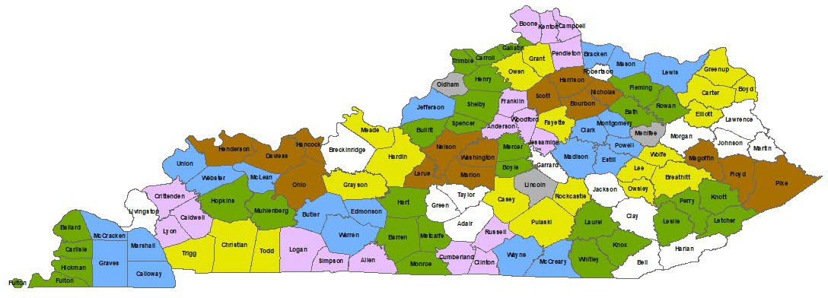
Community Early Childhood Councils
Notes:
Sally Shepherd
34 Community Early Childhood Councils in 120 105 Counties
A bit of a ‘call to action’. We’re asking you to ‘recommit’: What does your data say?
What are the strong programs in your community that are PROVEN to work for children?
Transition to Jessica Cunningham

Slide 10
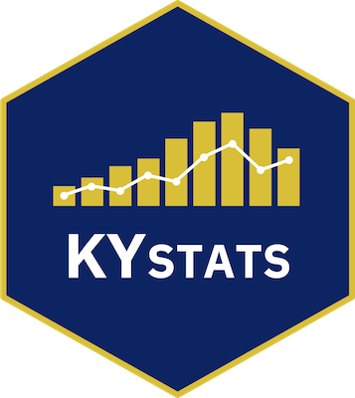
Kentucky Center for Statistics
Uniting our data
Informing our Commonwealth
August 2020
Notes:
Jessica Cunningham

Slide 11
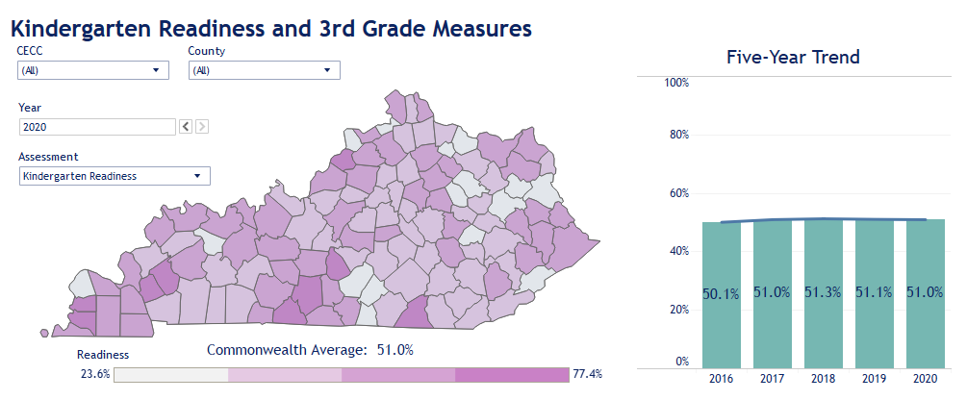
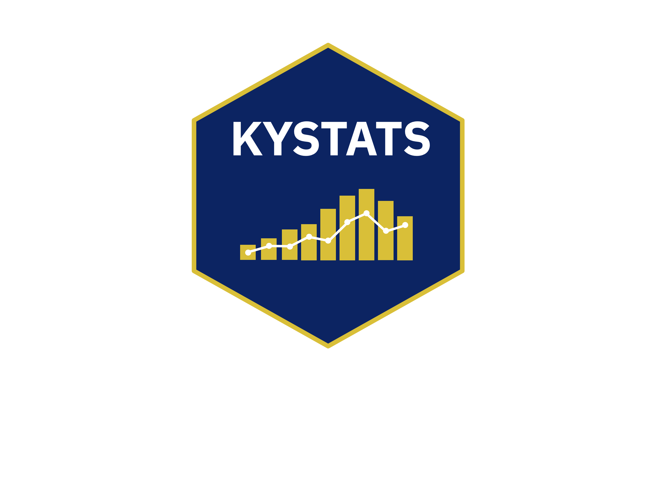
Kindergarten readiness has hovered around 51% for the last 5 years
Notes:
Jessica Cunningham

Slide 12
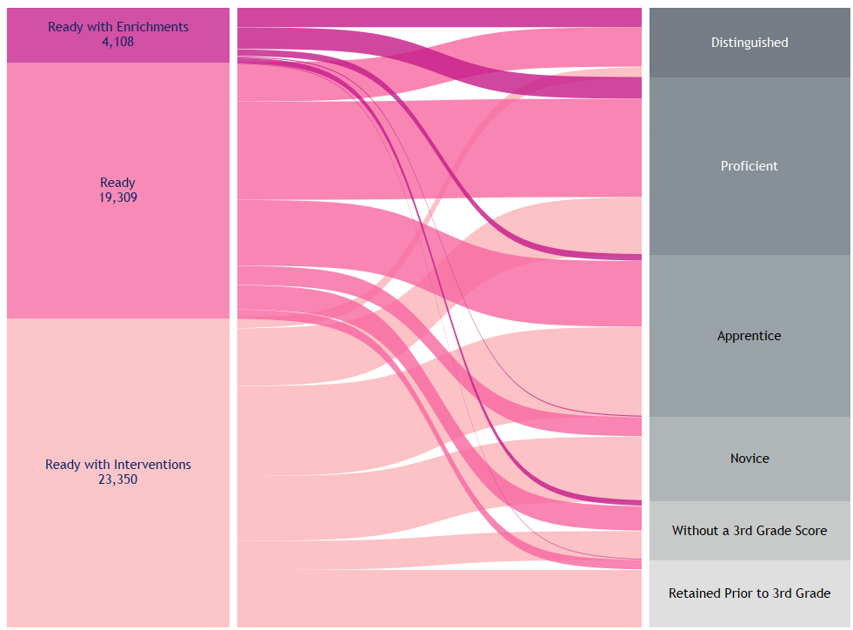
78% of kindergarteners ready with interventions were not proficient in 3rd grade math
22.1% of 2016 kindergarteners ready with interventions reached proficiency in 3rd grade math in 2019 (27.8% in reading).
53.8% of 2016 kindergarteners ready reached proficiency in 3rd grade math in 2019 (58% in reading).
75.3% of 2016 kindergarteners ready with enrichment reached proficiency in 3rd grade math in 2019 (76.9% in reading).
Notes:
Jessica Cunningham

Slide 13
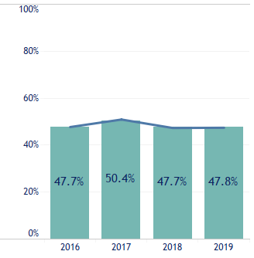
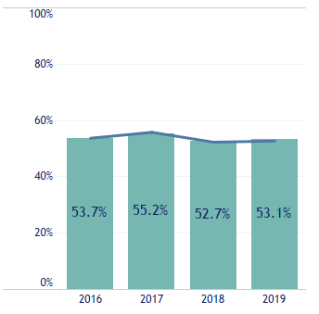
3rd Grade Testing Flat
Math
Proficiency
Reading
Proficiency
Notes:
Jessica Cunningham

Slide 14
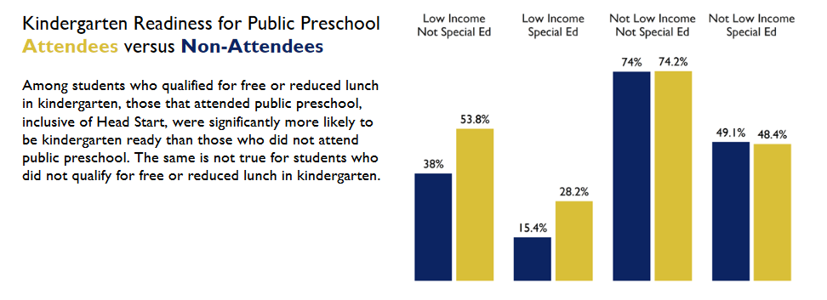
Income Eligible Preschool Students were significantly more likely to be kindergarten ready
Notes:
Jessica Cunningham

Slide 15
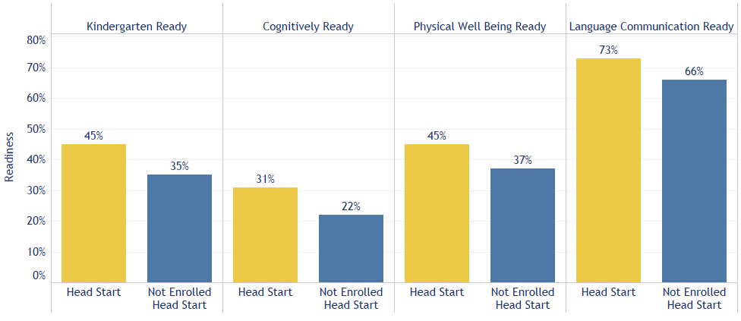
Head Start Students, on average, out scored eligible students who were not enrolled
Notes:
Jessica Cunningham

Slide 16
Children Opportunities
Statewide, approximately 53,000 children are eligible for preschool and/or Head Start for income or disabilities.
During Academic Year 2018, there were 34,000 individual children served in Head Start and/or public preschool.
An additional 19,000 (36% of all 3 and 4 Year Olds) eligible children could be enrolled in public preschool or Head Start.
Notes:
Jessica Cunningham
Early Childhood Profile (our website)— https://kystats.ky.gov/Reports/Tableau/ECP_2020
Kentucky Head Start Report (our website( send it out after Webinar
https://kystats.ky.gov/Reports/Tableau/KHSR_2020
The staff at the Governor’s Office of Early Childhood can send these out send out after Webinar
Turn Over to Sally Shepherd

Slide 17
Quality Early Childcare
Approximately 2,000 early child care providers with a capacity of 158,000 in August 2020
876 high quality participants (3 All STARS or higher) with a capacity of 77,000
Statewide, capacity for only 58% of births from 2014-2018

Slide 18
Prior Setting Data
Provide important information to communities.
Creating strong data collection plans to ensure prior settings data is accurate and reliable.
Plans should include current existing data, as well as collaboration with early care and education partners to assist with K Screener requirements.
Community Early Childhood Councils should assist with messaging and collection.
Notes:
Sally Shepherd
Turn Over to Amy

Slide 19
Requests from the Field
2017 provided the first evaluation for the Community Early Childhood Councils.
Anecdotal reports suggest strong participation and collaboration and significant leveraging of resources to maximize funding provided by the state.
Councils report that they implement 1-day family events where community partners come together to share resources, provide activities and distribute resources.
One Council reported using a valid and reliable measure.
Notes:
Amy Neal
Evaluation Findings-
Small investment; dilute potential impact
A reduction in the number of Community Early Childhood Councils
Strongly encourage leverage private local funding; award additional points to performance criterial for public/private partnerships
Getting us to Impact

Slide 20
Requests from the Field
Improved RFA Process
Improved Monitoring
Staffing
Cohesive Direction
Notes:
6-8 Weeks prior to due date for appropriate planning and writing of application
All identified children as the major motivator in the work—lack of clarity regarding the work and use of evidence-based practices
Defaulting in getting all partners to the table, lack of experience in grant writing, lack of information technology and knowledge and grant writing need to leverage local funding to spread work across an integrated system of local services
4. Governor’s Office of Early Childhood potential to be the ‘unite’ improved relationships, share best practices, special assistance struggling Community Early Childhood Councils, networking opportunities across Councils, Training new Chairs

Slide 21
Department of Community-Based Services
Public Libraries
Department of Education
Department of Health
Workforce Investment
The Business Community
Training Organizations
Advocacy/Public Policy Organizations
Foundations and Non-Profits
Notes:
Amy Neal
With the best intentions….we duplicate, are not as efficient as we could be, aren’t’ serving as many children as we could be: or growing the key strategies that are shown to work
Too often, we continue to work in our own silos and do thinks because ‘we’ve always done it this way’

Slide 22
Department of Community-Based Services
Department of Education
Department of Health
More Children Prepared for Kindergarten
Public Libraries
Workforce Investment
Business Community
Training Organizations
Advocacy/Public Policy Organizations
Foundations and Non-Profits
Notes:
Amy Neal
1. The work you do locally is a critical part the strategic plan
2. But without you—Kentucky cannot accomplish it’s mission. Without Aiming for the Same Target…it’s just not possible
All of our work is interconnected
If you are working in the birth-five space, we are asking you today to re-commit/commit to Kentucky’s shared vision:
Aiming for the Same Target: All Children Enter Kindergarten Prepared for Kindergarten

Slide 23
Kindergarten readiness has hovered around 51% for the last 5 years
Ensuring equity and healthy beginnings starts here—access, quality and outcomes.
State and local partnerships are critical to building a comprehensive early childhood system.
Kentucky's Community Early Childhood Councils are the vehicles to coordinate efforts that respond to local needs.
Notes:
Amy Neal
Using the evaluation and Data to drive our Next Step Webinars (every other month, opportunities connect peer-to-peer and highlight excellence in the field
Kentucky has elevated the importance of the early years for 20 years and has received millions of dollars from federal government to advance its work
Through Tobacco Settlement dollars, we invest over $1m a year local communities through 34 Community Early Childhood Councils
Yet still—49% of children were not ready last year

Slide 24
Call to Action
Broaden and deepen local partnerships; the problems are complex and interconnected.
Aim for a shared goal; work toward lasting change.
Understand the local assets; mobilize funding.
Follow the data; invest in proven strategies.
Notes:
Amy Neal
We cannot do this without your buy-in & partnership
We cannot reach our goals in the Commonwealth without: a shared Vision, mutually reinforcing strategies, shared measurement and

Slide 25

Thank you for your Attendance and Participation!

